Slide 1

IE 260 – ENGINEERING ECONOMY Chapter 4 The Time Value of Money - I
U. MAHİR YILDIRIM

Slide 2
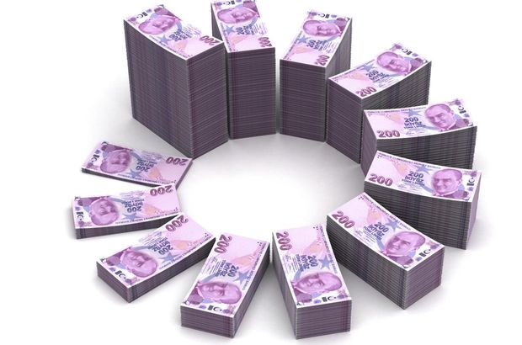
Chapter 4
The primary focus of Chapter 4 is to explain time value of money calculations and to illustrate economic equivalence.

Slide 3
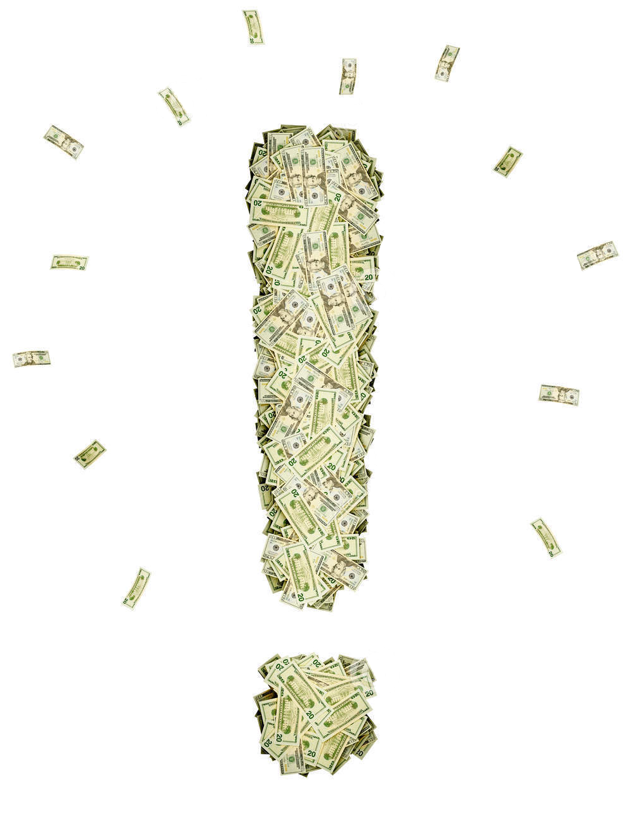
Chapter 4
All of the following weeks' topic will be based on the concept of the time value of money.

Slide 4
Introduction
Capital refers to wealth in the form of money or property that can be used to produce more wealth.
physical or non-physical ?
Engineering economy studies involve the commitment of capital for extended periods of time.
A ₺ today is worth more than a ₺ one or more years from now
Money has a time value !
comprises the physical and non-physical assets (such as education and skills)
Notes:
Anamal !

Slide 5

Introduction How to raise capital
Yourself
Family and friends
Banks
Angel investors
an affluent individual who provides capital for a business start-up, usually in exchange for convertible debt or ownership equity.
Venture capital
money provided by investors to startup firms with long-term growth potential
Crowdfunding
the practice of funding a project or venture by raising many small amounts of Money from a large number of people, typically via the Internet.
https://www.indiegogo.com
Notes:
Oculus rift – VR headset

Slide 6
Introduction (cont’d)
What would the investors expect if capital is invested in a project ?
to receive a return at least equal to the amount they have sacrificed by not using it in some other available opportunity of comparable risk.
Opportunity cost
The highest valued activity sacrificed in making a choice
interest or profit available from an alternative investment
The project and venture must provide a sufficient return to be financially attractive to suppliers of money or property
The remainder of this chapter deals with time value of Money principles, which are vitally important to the proper evaluation of engineering projects that form the foundation of a firm’s competitiveness, and hence to its very survival.

Slide 7

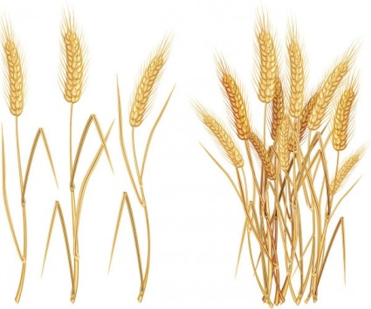


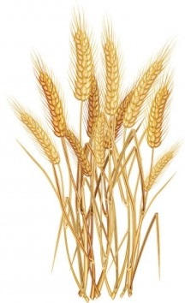

Early civilization ages
+
A
B
principal
interest
B
Notes:
The origins of interest
Wheat grain example

Slide 8
Interest
The rental price of money.
Payment for the risk the investor takes in permitting another person, or an organization, to use his or her capital.
Farmer A letting farmer B to use his wheat
Specifically, the interest rate is a percentage of principal paid a certain number of times per period for all periods during the total term of the loan or credit.
Interest rates are typically quoted on annual basis, even if period is less than a year

Slide 9
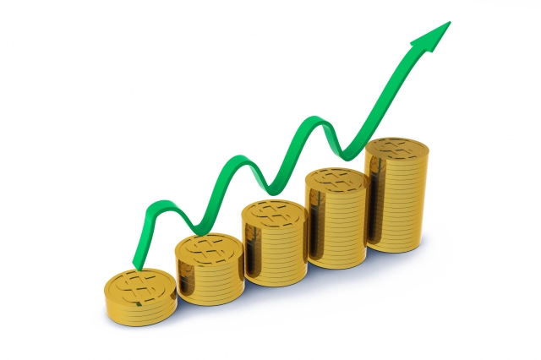
Objective
Given a cash flow (or series of cash flows) occurring at some point in time, the objective is to find its equivalent value at another point in time considering the time value of money.
Two Ways for Calculating the Time-Value of Money: – Simple Interest – Compound Interest

Slide 10
Simple Interest
100 gr of grain as interest for 1 kg borrowed for 1 year
When the amount of interest earned (or paid) is directly proportional to
the principal of the loan,
the number of interest periods for which the principal is committed,
and the interest rate per period
the interest rate is said to be simple.
+
More than 1 year
+
200 gr interest payment for 1 kg borrowed for 1 year
+
Notes:
3 different person.
1 – What if 2 kg is borrowed?
2 – What if borrowed for 2 years?
3 – What if 200 gr interest payment?

Slide 11
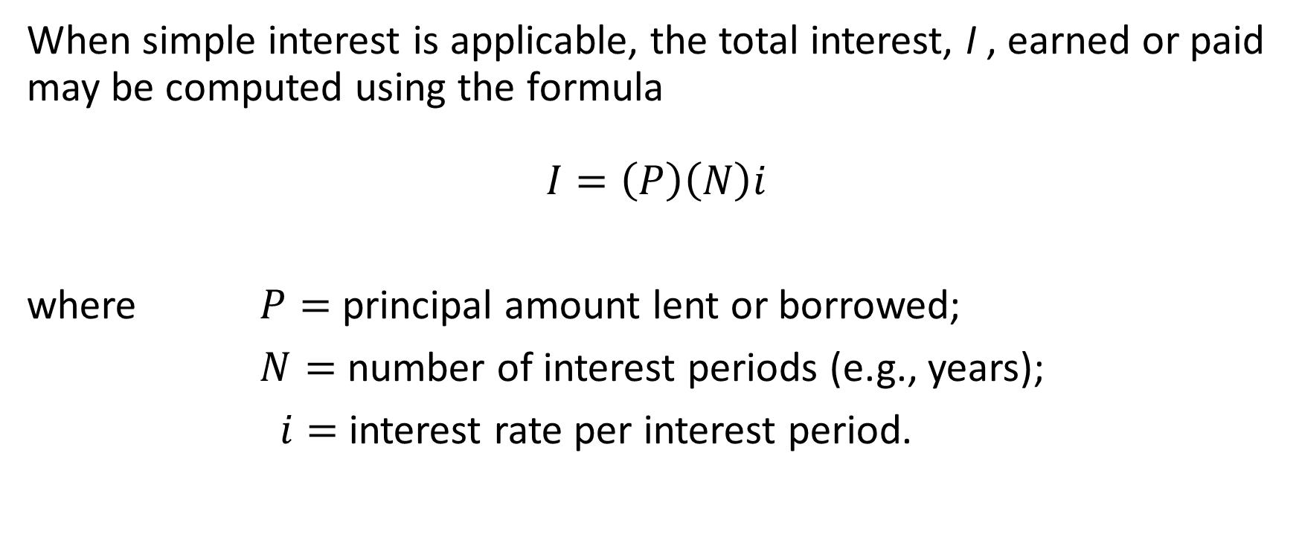
Simple Interest Calculation
When simple interest is applicable, the total interest, I , earned or paid may be computed using the formula
$$I=\left(P\right)\left(N\right)i$$
where $P=$ principal amount lent or borrowed;
$N=$ number of interest periods (e.g., years);
$i=$ interest rate per interest period.

Slide 12
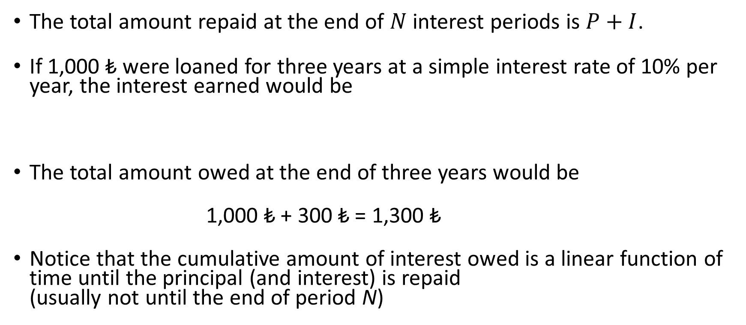
Simple Interest Calculation (cont’d)
?
The total amount repaid at the end of $N$ interest periods is $P+I$.
If 1,000 ₺ were loaned for three years at a simple interest rate of 10% per year, the interest earned would be
The total amount owed at the end of three years would be
1,000 $\text{₺}$ + 300 $\text{₺}$ = 1,300 $\text{₺}$
Notice that the cumulative amount of interest owed is a linear function of time until the principal (and interest) is repaid (usually not until the end of period N)
?
$$I=1,000\text{₺ }\text{x} 3 \text{x} 0.10=300\text{₺}$$

Slide 13

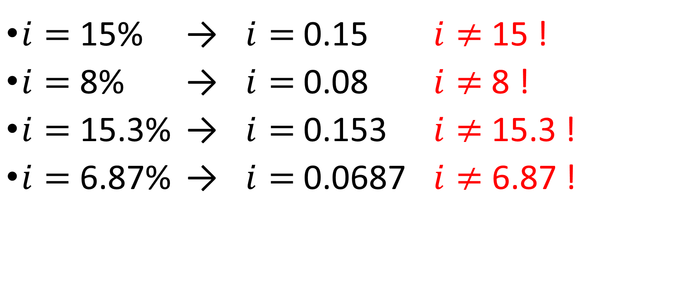
$i=$ 15% → $i=$0.15 $i≠$15 !
$i=$ 8% → $i=$0.08 $i≠$8 !
$i=$ 15.3% → $i=$0.153 $i≠$15.3 !
$i=$ 6.87% → $i=$0.0687 $i≠$ 6.87 !

Slide 14
Example Simple Interest
If 10,000 ₺ were loaned for 4 months at a simple interest rate of 15% per year, what would the interest earned be ?
I = 10,000 ₺ x 4/12* 15% = 500 ₺
The interest period N is 4/12=0.33 so the interest earned is 0.33*15%=5% for the period
Name | Interest Period | N
Annual | 1 year | 1
Semi annual | 6 months | 1/2 = 0.5
Quarterly | 3 months | 1/4 = 0.25
Monthly | 1 month | 1/12
Daily | 1 day | 1/360
 |  | 1/365

Slide 15
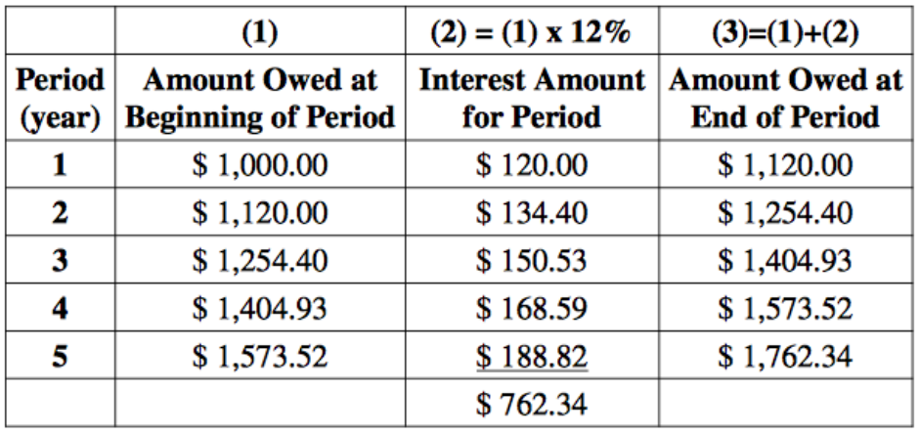
Compound Interest
The amount of interest earned (or paid) per interest period depends on the remaining principal of the loan plus any unpaid interest charges

Slide 16
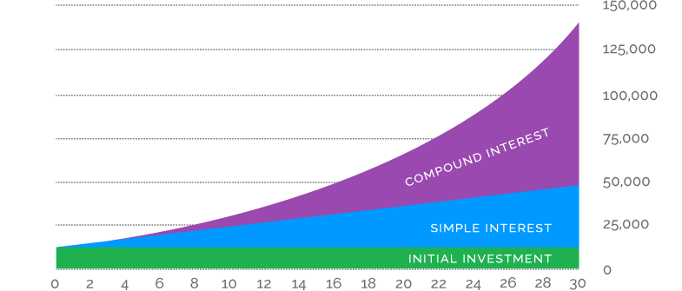
Simple vs Compound Interest
The difference is due to the effect of compounding, which is essentially the calculation of interest on previously earned interest.
Simple interest does consider the time value of money but does not involve compounding of interest.

Slide 17
The Concept of Equivalence
How can alternatives for providing the same service or accomplishing the same function be compared when interest is involved over extended periods of time?
Economic equivalence exists between cash flows that have the same economic effect and could therefore be traded for one another (i.e. they are equally desirable - indifferent)

Slide 18
The Concept of Equivalence (cont'd)
Even though the amounts and timing of the cash flows may differ, the appropriate interest rate makes them equal.
Each alternative can be reduced to an equivalent basis dependent on – the interest rate, – the amounts of money involved, – the timing of the monetary receipts or expenses.

Slide 19
The Concept of Equivalence (cont’d)
If the interest rate is 6% per year, $100 today (present time) is equivalent to $106 one year from today. Amount accrued = 100 + 100(0.06) = 100(1 + 0.06) = $106
$100 today vs $106 one year from today ?
In either case you have $106 one year from today.
However, the two sums of money are equivalent to each other only when the interest rate is 6% per year. At a higher or lower interest rate, $100 today is not equivalent to $106 one year from today.
Notes:
If someone offered you a gift of $100 today or $106 one year from today, it would make no difference which offer you accepted from an economic perspective.

Slide 20
Example The Concept of Equivalence
Amount of Principal = $ 8000
Interest rate = 10% /yr. (per year = annual)
Duration of the loan = 4 years
Consider two different payment plans to see the meaning of equivalence.
Plan1: At the end of each year pay $2000 principal plus interest due.
Plan2: Pay principal and interest in one payment at the end of four years.

Slide 21
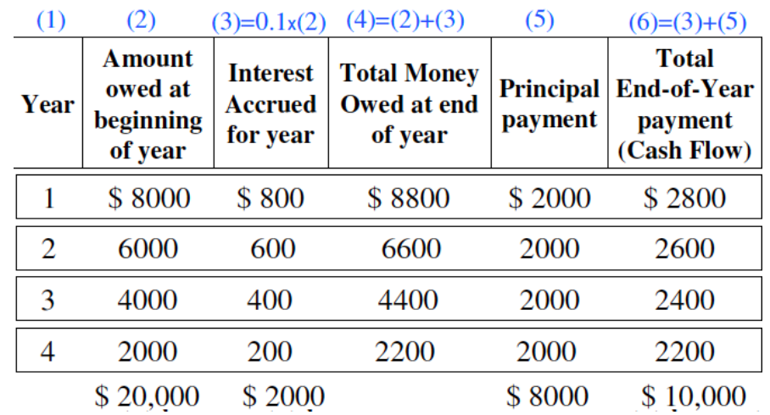
Example The Concept of Equivalence – Plan 1
Pay $2000 principal plus interest due at the end of each year

Slide 22
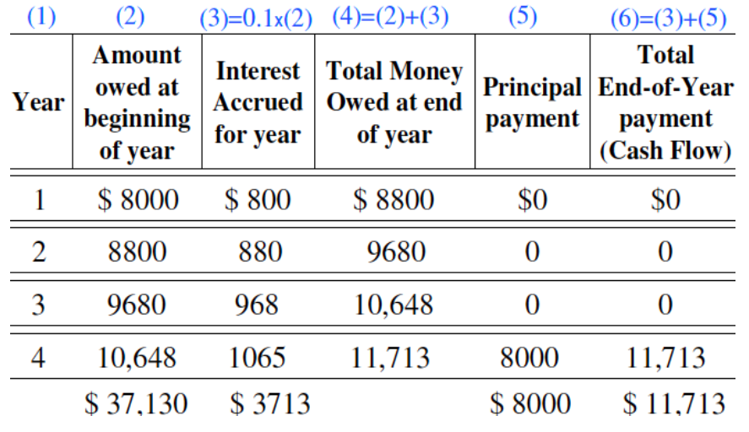
Example The Concept of Equivalence – Plan 2
Pay principal and interest in one payment at the end of four years

Slide 23
Example Plan 1 vs Plan 2

Slide 24
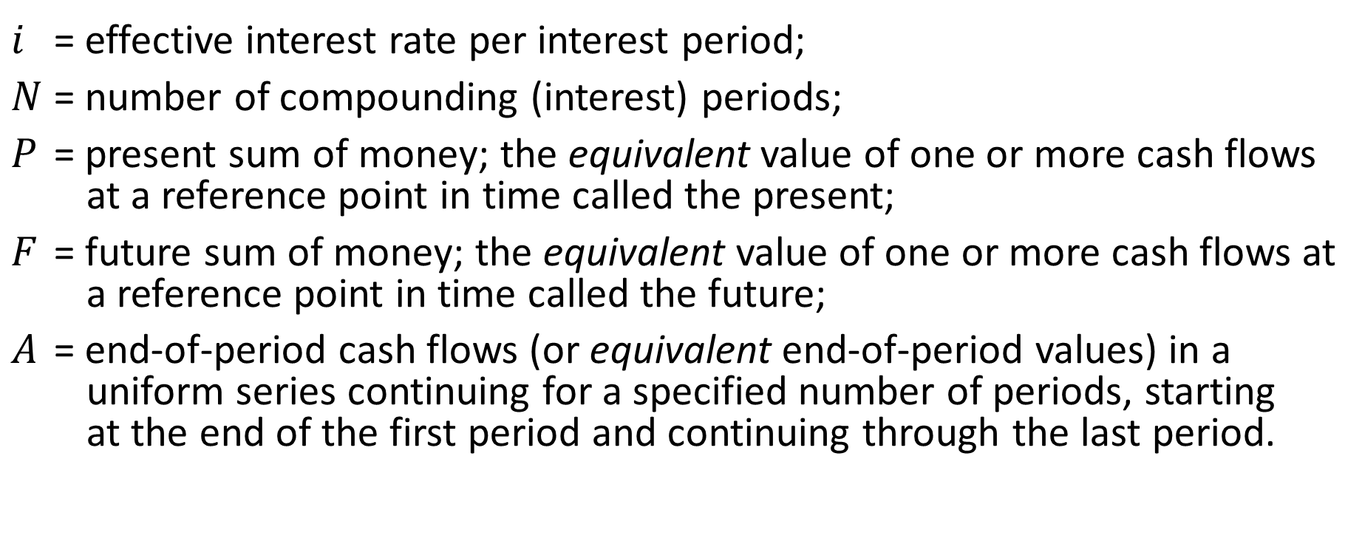
Notation of Cash-Flow Diagrams and Tables
$i$ = effective interest rate per interest period;
$N$ = number of compounding (interest) periods;
$P$ = present sum of money; the equivalent value of one or more cash flows at a reference point in time called the present;
$F$ = future sum of money; the equivalent value of one or more cash flows at a reference point in time called the future;
$A$ = end-of-period cash flows (or equivalent end-of-period values) in a uniform series continuing for a specified number of periods, starting at the end of the first period and continuing through the last period.

Slide 25
Cash Flow Diagram
BORROWER
Suppose you borrow 1,000 ₺ at the beginning of year 1.
Each year, you make a payment of 200 ₺.
At the end of the 5th year you make a payment of 200 ₺ plus the principal that you borrowed.
1,000 ₺
End of year 1
INFLOWS
1
2
3
4
5
0
200 ₺
200 ₺
200 ₺
200 ₺
Beginning of year 1
OUTFLOWS
1,200 ₺
Notes:
The horizontal line is a time scale, with progression of time moving from left to right. The period (e.g., year, quarter, month) labels can be applied to intervals of time rather than to points on the time scale. Note, for example, that the end of Period 2 is coincident with the beginning of Period 3. When the end-of-period cash-flow convention is used, period numbers are placed at the end of each time interval
The cash-flow diagram is dependent on the point of view.

Slide 26
Cash Flow Diagram
BORROWER
LENDER
1200 ₺
1,000 ₺
End of year 1
INFLOWS
200 ₺
200 ₺
200 ₺
200 ₺
1
2
3
4
5
0
0
1
2
3
4
5
200 ₺
200 ₺
200 ₺
200 ₺
Beginning of year 1
OUTFLOWS
1,200 ₺
1,000 ₺
Notes:
The horizontal line is a time scale, with progression of time moving from left to right. The period (e.g., year, quarter, month) labels can be applied to intervals of time rather than to points on the time scale. Note, for example, that the end of Period 2 is coincident with the beginning of Period 3. When the end-of-period cash-flow convention is used, period numbers are placed at the end of each time interval
The cash-flow diagram is dependent on the point of view.

Slide 27
Cash Flows of Plans 1 & 2
Borrower’s viewpoint | Plan 1 | Plan 2
End of Year (EOY) | Cash Flows | Cash Flows
0 | $ 8,000 | $ 8,000
1 | - 2,800 | 0
2 | - 2,600 | 0
3 | - 2,400 | 0
4 | - 2,200 | - 11,713
Lender’s viewpoint | Plan 1 | Plan 2
?
Lender’s viewpoint | Plan 1 | Plan 2
End of Year (EOY) | Cash Flows | Cash Flows
0 | - $ 8,000 | - $ 8,000
1 | 2,800 | 0
2 | 2,600 | 0
3 | 2,400 | 0
4 | 2,200 | 11,713
Cash Flow Diagrams from both viewpoints ?

Slide 28
Cash Flow Diagrams of Plans 1 & 2 from Borrower’s viewpoint
8,000
8,000
Plan 1
Plan 2
1
2
3
4
1
2
3
4
0
0
2,400
2,200
2,800
2,600
11,713

Slide 29
Cash Flow Diagrams of Plans 1 & 2 from Lender’s viewpoint
Plan 1
Plan 2
11,713
2,800
2,600
2,400
2,200
0
0
1
2
3
4
1
2
3
4
8,000
8,000

Slide 30
The Concept of Equivalence
If two options has the same value at any time taking the time value of money into account, then they are equivalent.
0
1
2
3
N

Slide 31
Interest Formulas Relating to Single Cash Flows
How to find the Future Equivalent value of a Present Sum of Money
That is, find F when P is given.
How to find the Present Equivalent value of a Future Sum of Money
That is, find P when F is given.

Slide 32
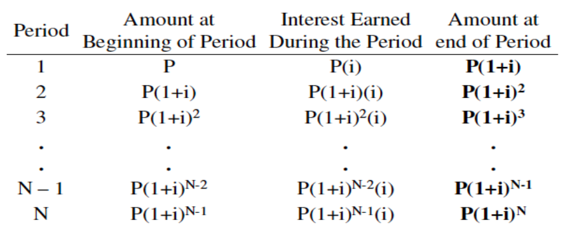
How to find the Future Equivalent value of a Present Sum of Money - Finding F given P is given

Slide 33
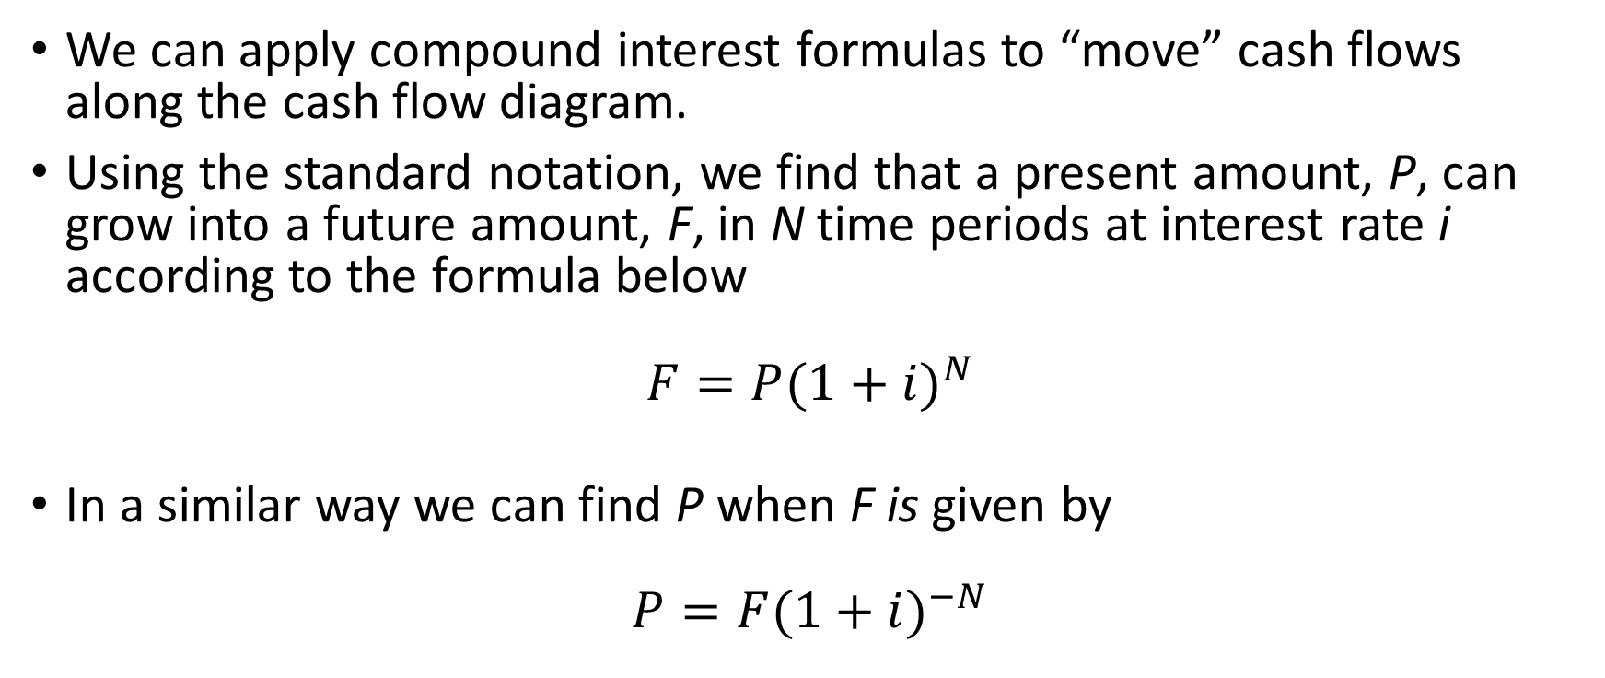
Finding F when P is given
We can apply compound interest formulas to “move” cash flows along the cash flow diagram.
Using the standard notation, we find that a present amount, P, can grow into a future amount, F, in N time periods at interest rate i according to the formula below
$$F=P{(1+i)}^{N}$$
In a similar way we can find P when F is given by
$$P=F{(1+i)}^{−N}$$

Slide 34
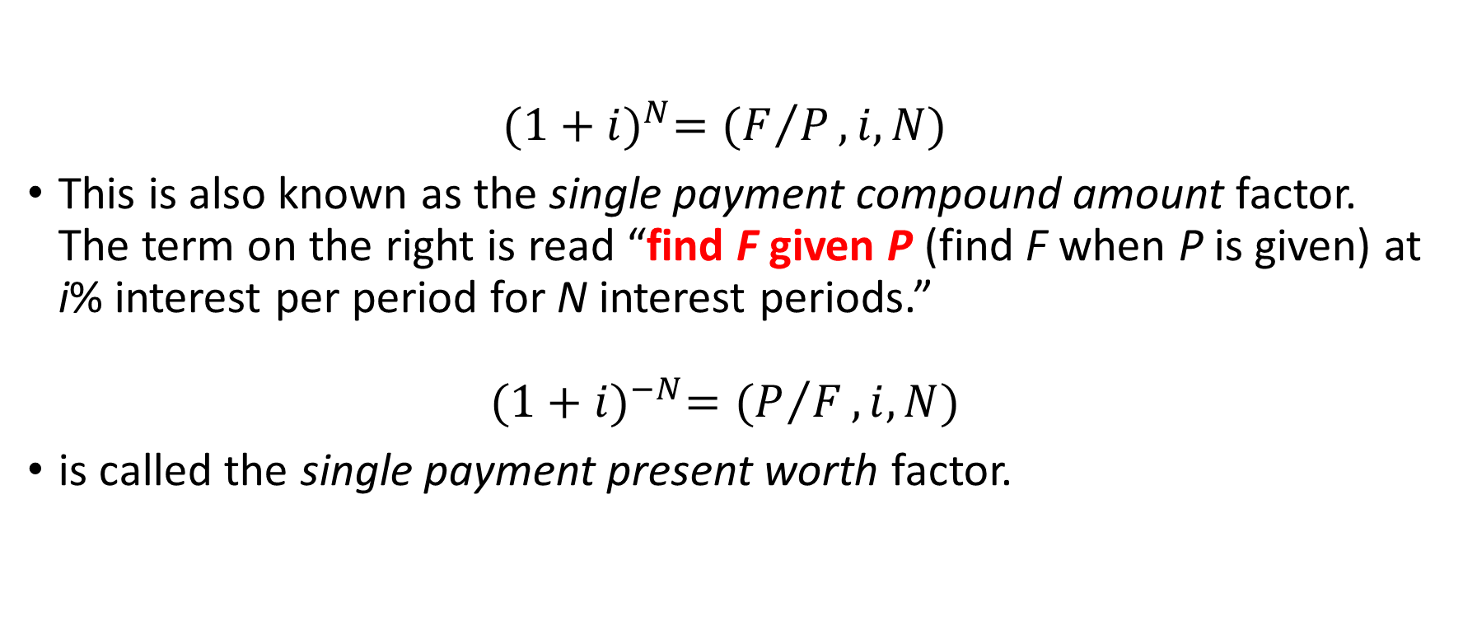
Standard notation for interest factors
$${(1+i)}^{N}=(F/P,i,N)$$
This is also known as the single payment compound amount factor. The term on the right is read “find F given P (find F when P is given) at i% interest per period for N interest periods.”
$${(1+i)}^{−N}=(P/F,i,N)$$
is called the single payment present worth factor.

Slide 35

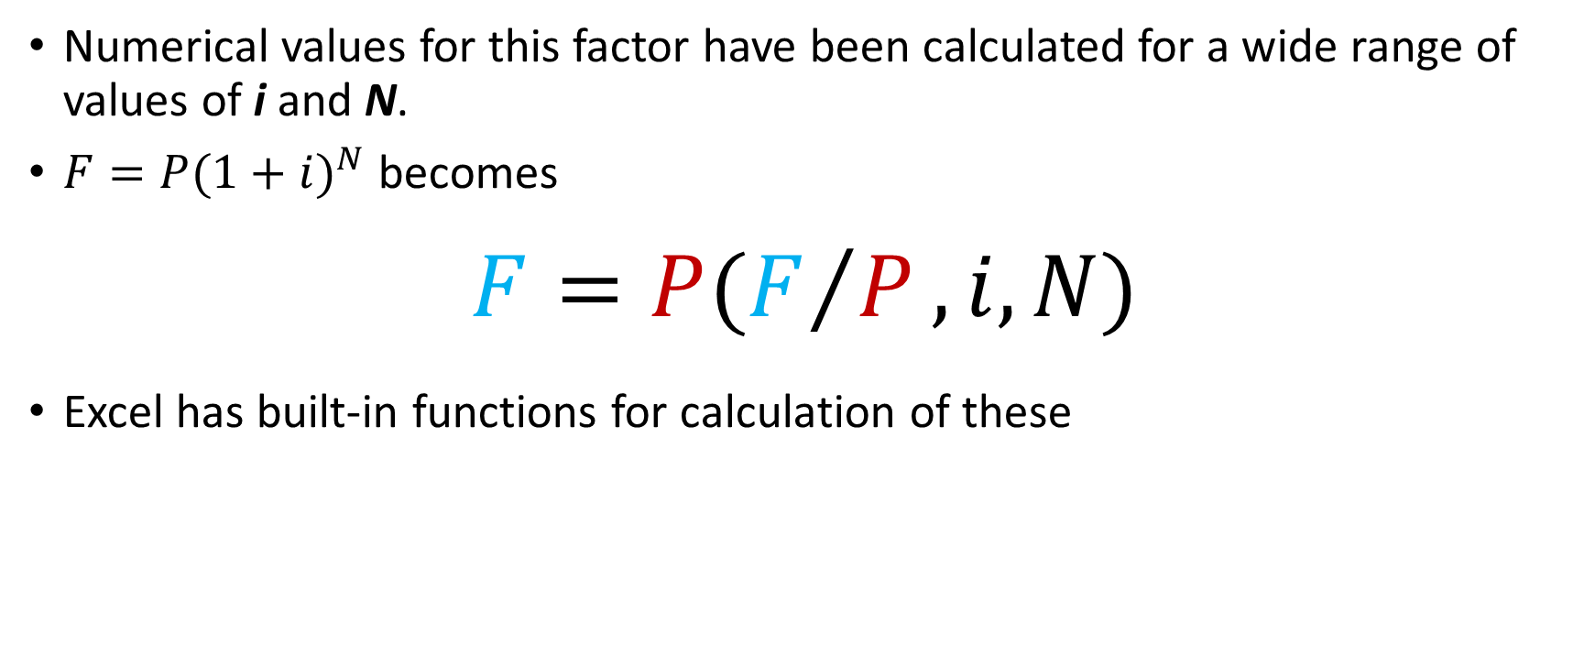
Single Payment Compound Amount Factor
Numerical values for this factor have been calculated for a wide range of values of i and N.
$F=P{(1+i)}^{N}$ becomes
$$F=P(F/P,i,N)$$
Excel has built-in functions for calculation of these
0 or «Omitted» for End of period payment 1 for Beginning of period
payment made each period (use 0)
present value
interest rate per period
number of periods

Slide 36
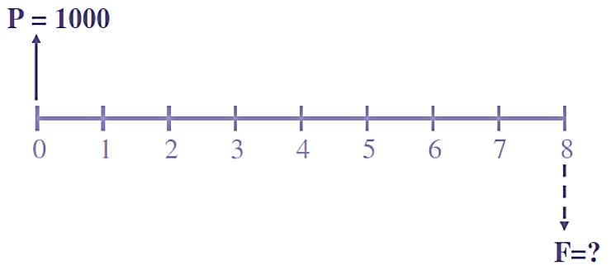
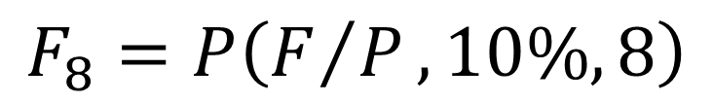
Example Finding F given P
A firm borrows $1000 for eight years at i = 10%. How much must it repay in a lump sum at the end of eighth year ?
$$F_{8}=P\left(F/P,10\%,8\right)$$
Find F given P
interest rate
periods

Slide 37
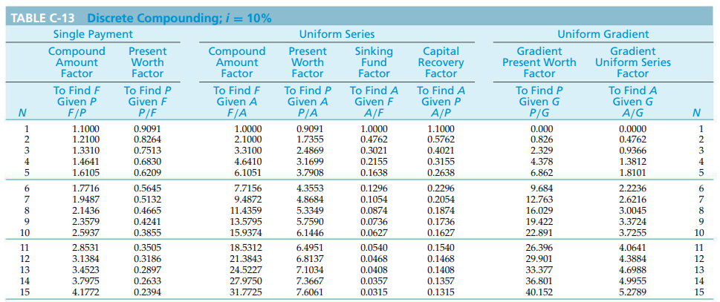

Reading Interest Table - $\left(F/P,10\%,8\right)$

Slide 38



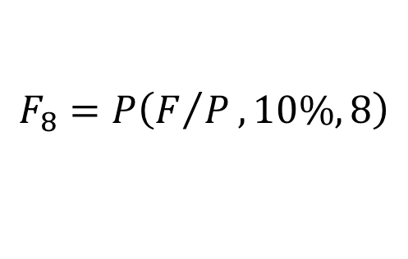
Example Finding F given P
A firm borrows $1000 for eight years at i = 10%. How much must it repay in a lump sum at the end of eighth year ?
$$F_{8}=P\left(F/P,10\%,8\right)$$
$$=1,000\left(2.1436\right)=\$2,143.6$$
$$F_{8}=P{(1+10\%)}^{8}=1,000{(1.1)}^{8}$$
$$=1,000\left(2.1436\right)=\$2,143.6$$
Excel formula
= FV (10%; 8; 0; 1000; 0)

Slide 39

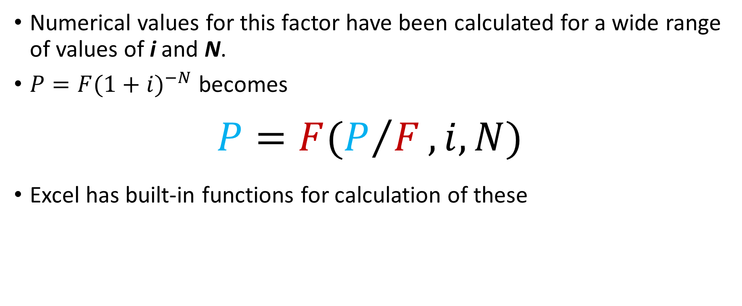
Single Payment Present Worth Factor
Numerical values for this factor have been calculated for a wide range of values of i and N.
$P=F{(1+i)}^{−N}$ becomes
$$P=F(P/F,i,N)$$
Excel has built-in functions for calculation of these
0 or «Omitted» for End of period payment 1 for Beginning of period
payment made each period (use 0)
future value
interest rate per period
number of periods

Slide 40
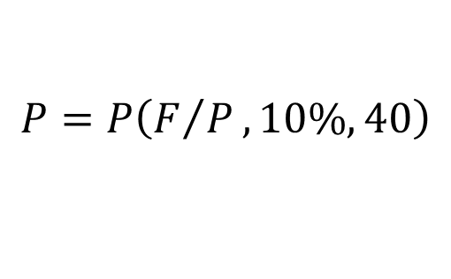

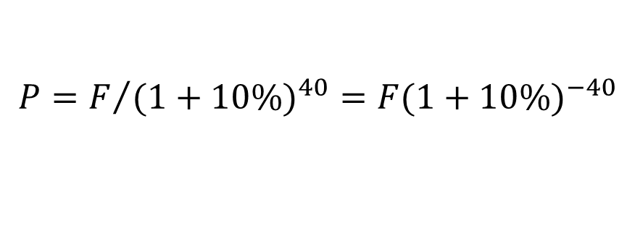
Example Finding P given F
How much would you have to deposit now into an account paying 10% interest per year in order to have $1,000,000 in 40 years ?
$$P=P\left(F/P,10\%,40\right)$$
$$=1,000,000\left(0.0221\right)=\$22,094.93$$
$$P=F/{{(1+10\%)}^{40}}=F{(1+10\%)}^{−40}$$
$$=1,000,000{(1.1)}^{−40}=\$22,094.93$$
Excel formula
= PV (10%; 40; 0; 1000000; 0)

Slide 41
Example Economically equivalent values at different points in time
$2,500 at time zero is equivalent to how much after six years if the interest rate is 8% per year ?

Slide 42
Example Economically equivalent values at different points in time
$3,000 at the end of year seven is equivalent to how much today (time zero) if the interest rate is 6% per year ?

Slide 43
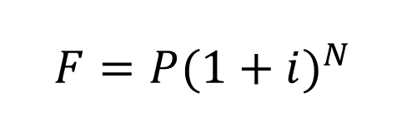
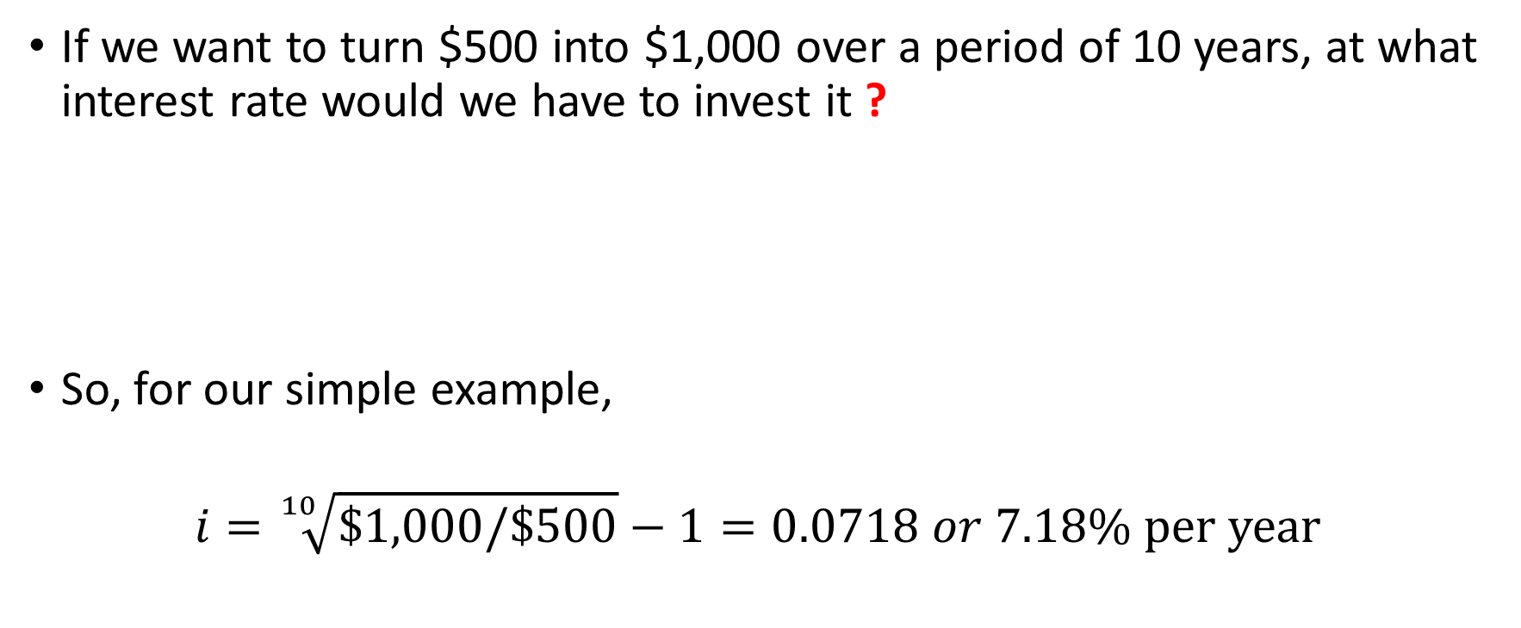
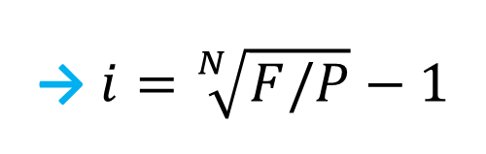
Finding the Interest Rate Given P, F, and N
If we want to turn $500 into $1,000 over a period of 10 years, at what interest rate would we have to invest it ?
So, for our simple example,
$$i=\sqrt[10]{\$1,000/\$500}−1=0.0718 or 7.18\% \text{per} \text{year}$$
$$F=P{(1+i)}^{N}$$
→ $i=\sqrt[N]{F/P}−1$

Slide 44
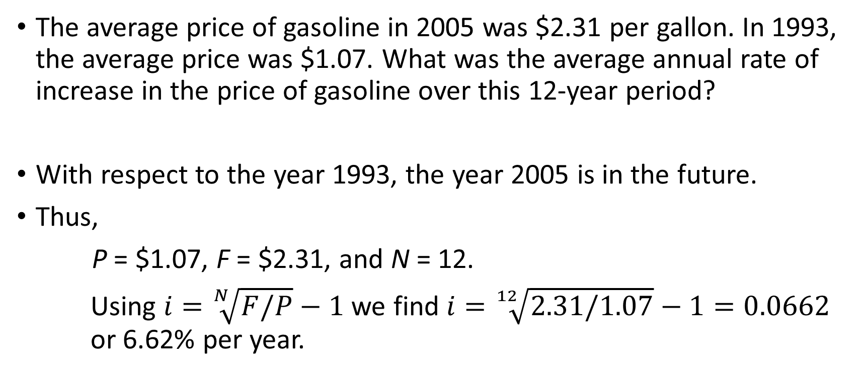
Example The Inflating Price of Gasoline
The average price of gasoline in 2005 was $2.31 per gallon. In 1993, the average price was $1.07. What was the average annual rate of increase in the price of gasoline over this 12-year period?
With respect to the year 1993, the year 2005 is in the future.
Thus,
P = $1.07, F = $2.31, and N = 12.
Using $i=\sqrt[N]{F/P}−1$ we find $i=\sqrt[12]{2.31/1.07}−1=0.0662$ or 6.62% per year.

Slide 45
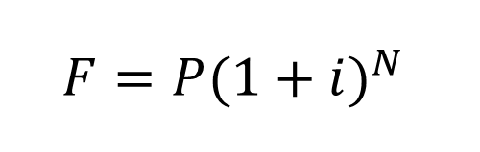
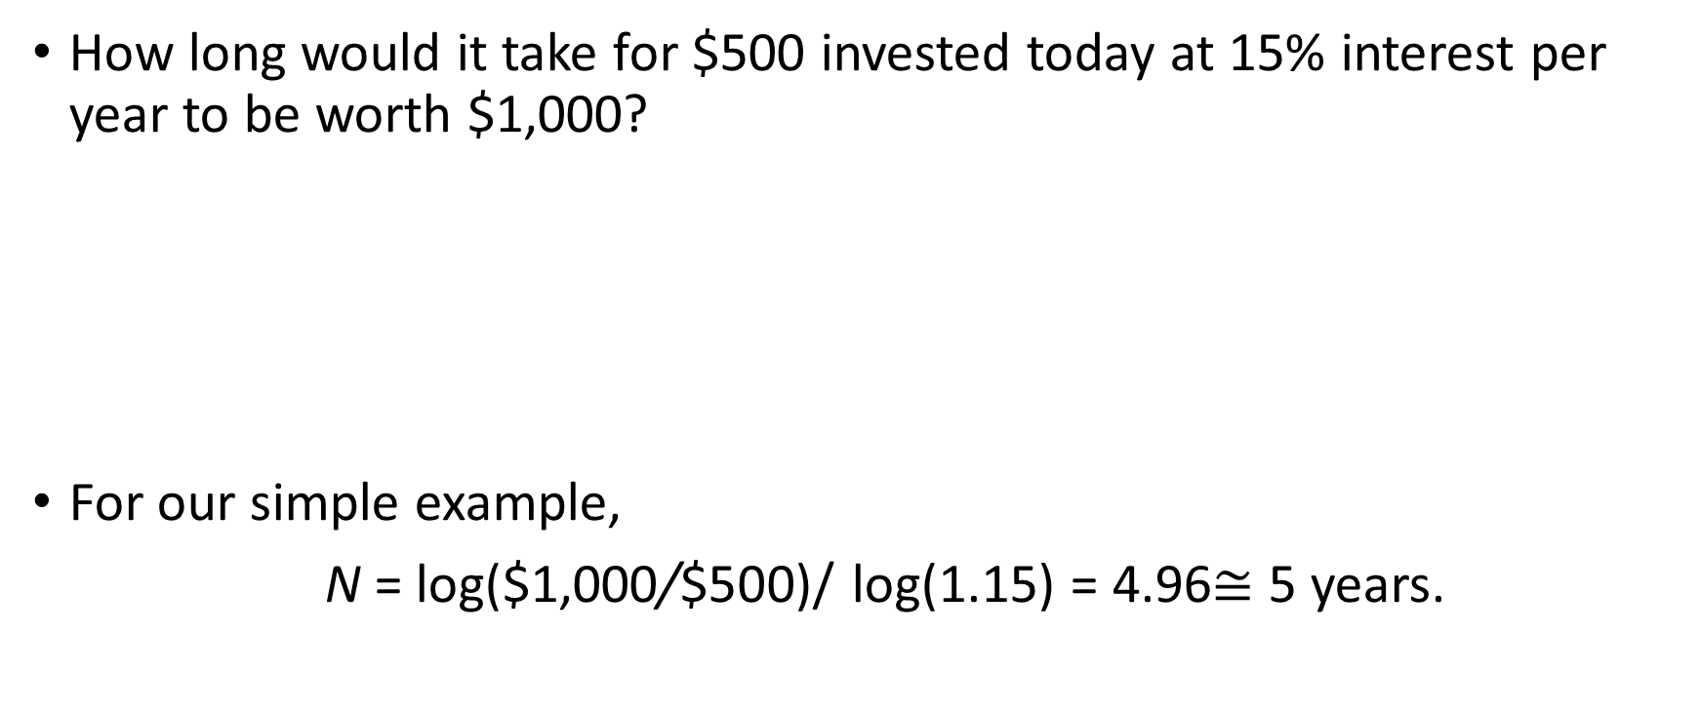
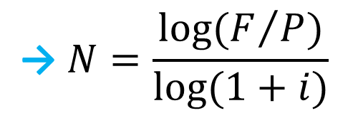
Finding N when Given P, F, and i
How long would it take for $500 invested today at 15% interest per year to be worth $1,000?
For our simple example,
N = log($1,000/$500)/ log(1.15) = 4.96$≅$ 5 years.
$$F=P{(1+i)}^{N}$$
$$\text{→} N=\frac{log⁡(F/P)}{log⁡(1+i)}$$

Slide 46
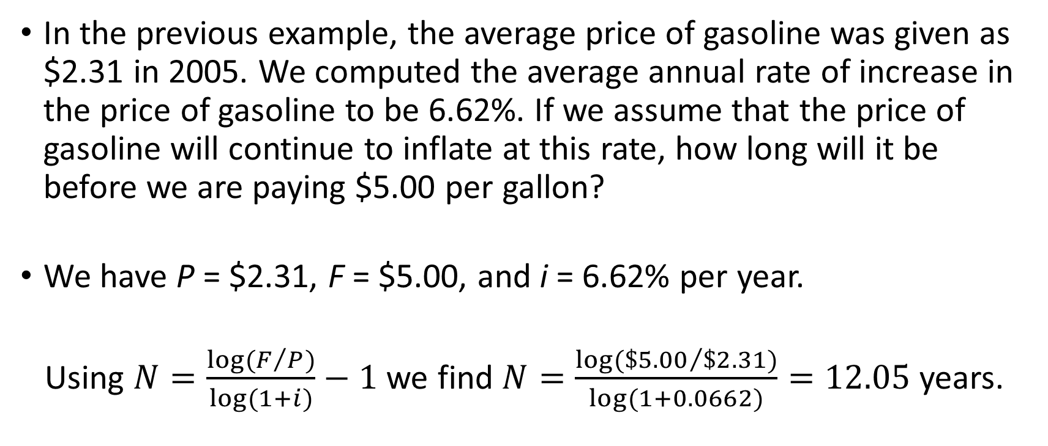
Example When Will Gasoline Cost $5.00 per Gallon?
In the previous example, the average price of gasoline was given as $2.31 in 2005. We computed the average annual rate of increase in the price of gasoline to be 6.62%. If we assume that the price of gasoline will continue to inflate at this rate, how long will it be before we are paying $5.00 per gallon?
We have P = $2.31, F = $5.00, and i = 6.62% per year.
Using $N=\frac{log⁡(F/P)}{log⁡(1+i)}−1$ we find $N=\frac{log⁡({\$5.00}/{\$2.31})}{log⁡(1+0.0662)}=12.05$ years.

Slide 47
Relating a Uniform Series (Annuity) to Its Present and Future Equivalent Values
A series of uniform (equal) receipts, each of amount A, occurring at the end of each period for N periods with interest at i% per period
A
A
A
A
A
P (present equivalent value) occurs one interest period before the first A (uniform amount),
F (future equivalent value) occurs at the same time as the last A, and N periods after P, and
A (annual equivalent value) occurs at the end of periods 1 through N, inclusive.
0
1
2
3
4
5
P = Present Equivalent
F = Future Equivalent

Slide 48
Annuity Finding F when Given A
A
A
A
A
P
≈
. . .
. . .
0
1
2
N-1
N
-1
0
1
N-2
N-1
F = ?
F = ?
F = P(F/P, i%, N - 1)

Slide 49
Annuity Finding F when Given A (cont’d)
A
A
A
A
P
≈
. . .
. . .
0
1
2
N-1
N
-2
-1
0
N-3
N-2
F = ?
F = ?
F = P(F/P, i%, N - 2)

Slide 50

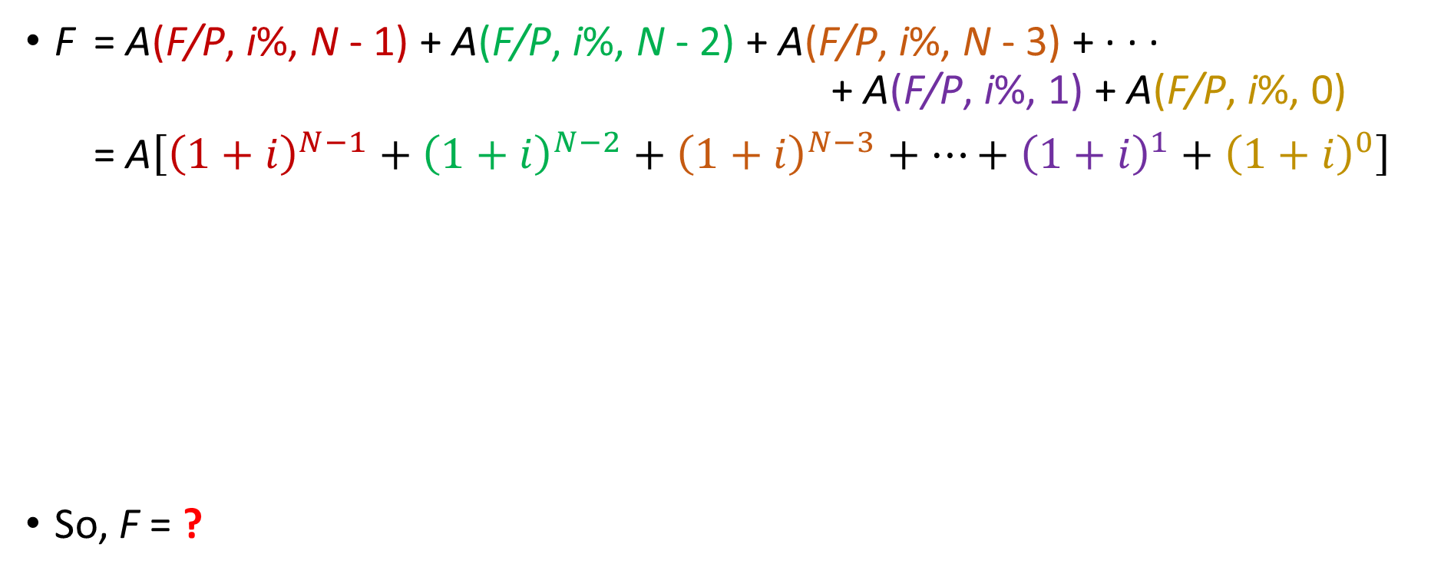
Annuity Finding F when Given A (cont’d)
F = A(F/P, i%, N - 1) + A(F/P, i%, N - 2) + A(F/P, i%, N - 3) + · · · + A(F/P, i%, 1) + A(F/P, i%, 0)
= A$\left[{\left(1+i\right)}^{N−1}+{\left(1+i\right)}^{N−2}+{\left(1+i\right)}^{N−3}+…+{\left(1+i\right)}^{1}+{\left(1+i\right)}^{0}\right]$
So, F = ?
a geometric sequence

Slide 51

Annuity Finding F when Given A (cont’d)
$F=A\left[\frac{{(1+i)}^{N}−1}{i}\right]$
$F=A$($F$/$A$, $i$%, $N$)
Base
uniform series compound amount factor

Slide 52
Example Future Value of a College Degree
A recent government study reported that a college degree is worth an extra $23,000 per year in income (A) compared to what a high-school graduate makes. If the interest rate (i) is 6% per year and you work for 40 years (N), what is the future compound amount (F) of this extra income?

Slide 53
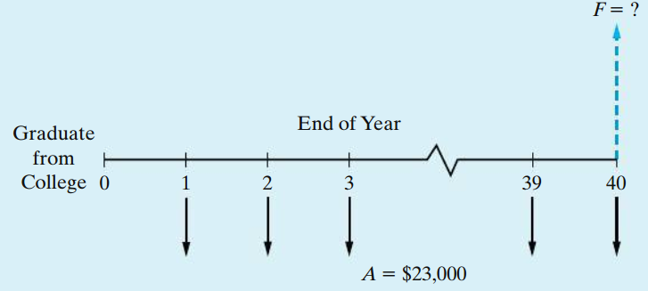
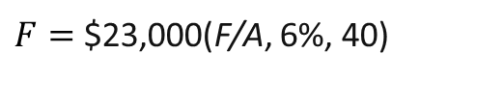

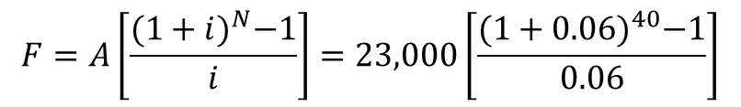
Solution Future Value of a College Degree
The viewpoint we will use to solve this problem is that of “lending” the $23,000 of extra annual income to a savings account (or some other investment vehicle). The future equivalent is the amount that can be withdrawn after the 40th deposit is made.
$F=$ $23,000(F/A, 6%, 40)
$$F=A\left[\frac{{(1+i)}^{N}−1}{i}\right]=23,000\left[\frac{{(1+0.06)}^{40}−1}{0.06}\right]$$
$$F=\$3,559,526$$

Slide 54
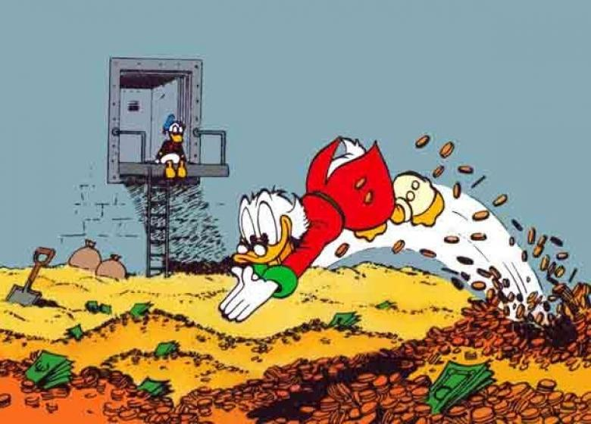
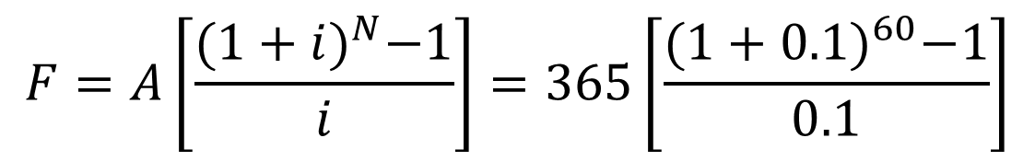


Example Becoming a Millionaire by Saving $1.00 a Day!
If you are 20 years of age and save $1.00 each day for the rest of your life, can you become a millionaire ?
Let’s assume that you live to age 80 & i = 10%
$F=$ $365/year (F/A, 10%, 60 years)
$$F=A\left[\frac{{(1+i)}^{N}−1}{i}\right]=365\left[\frac{{(1+0.1)}^{60}−1}{0.1}\right]$$
$$F=\$1,107,708$$

